Slide 1
Statistical Analysis

Slide 2
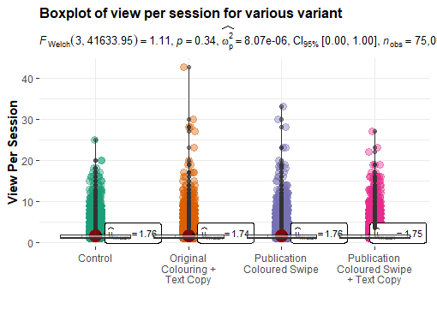
Reading the Data
The data is imported into the R studio using libraries.
Checked for null values.
Checked for outliers by plotting the boxplot.

Slide 3
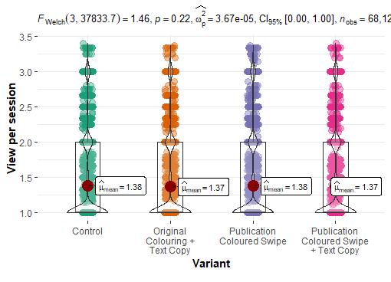
Data without Outliers
Performed Inter Quartile Range to remove the outliers from the data.
Plotted the boxplot without outliers

Slide 4
Assumptions of the ANOVA test
Normality of the data.
Equality in the Variances of the data.
Independence of observations.

Slide 5
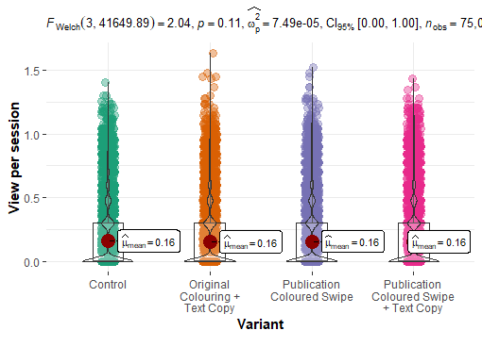
ANOVA test
Null Hypothesis (H0): There is no statistically significant difference between the groups of the experiment
Alternate Hypothesis (H1): There is a statistically significant difference between the groups of the experiment.
After performing the statistical test on the dataset. The p-value is greater than the significance level, we failed to reject the null hypothesis.
So, there is no statistically significant difference between the groups.

Slide 6

Group that performed optimally is Control.
Based on the average of all the groups, no experimental group out performed the Control group.

Slide 7
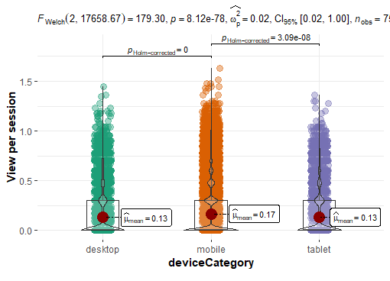
ANOVA test for Device Category
Null Hypothesis (H0): There is no statistically significant difference between the performance of the device.
Alternate Hypothesis (H1): There is a statistically significant difference between the performance of the device.
After performing the statistical test on the dataset, the p-value is less than the significance level (0.05)
There is a statistically significant difference between the performance of the device.

Slide 8
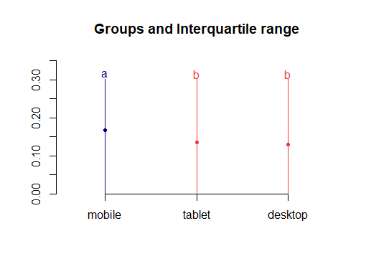
By performing the post hoc test, the device which performed optimally is mobile.

Slide 9
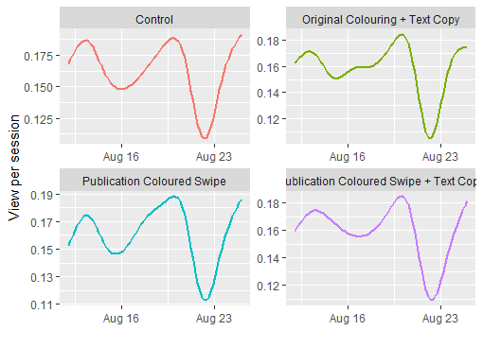
Based on Time
The results from the graph state that there is no significant difference between the between the groups as a product of time.
We can also say that the results are stable over the time.

Slide 10
If the results are not statistically significant, the methods which could be adopted:
To check the statistical significant difference, we have to test all the features on one device at a time.

Slide 11
To summarise the findings, there is a significant difference in the means of the device category.
It gives insight that mobile performed well compared to desktop or tablet.
As mobile is more handy than other devices, it was easy for users to view more pages which increases the page view per session.
We can also say that results based on time, there was no significant difference between the groups and were stable over the time period.
Increased page views, engaged time can increase the revenue growth.

Slide 12
We can categorise this experiment based on the devices
Users familiarity with the technology.
Age of the participant can also impact the result of the experiment.
The result can also be dependent up on time duration of the session.

Slide 13
There is a possibility for the potential iteration of this experiment to test the evolved features.

